Slide 1
Chapter 7
Arrays and Strings

Slide 2
Objectives (1 of 3)
In this chapter, you will:
  Learn the reasons for arrays
  Explore how to declare and manipulate data into arrays
  Understand the meaning of ‘‘array index out of bounds’’
  Learn how to declare and initialize arrays
  Become familiar with the restrictions on array processing

Slide 3
Objectives (2 of 3)
  Discover how to pass an array as a parameter to a function
  Learn how to search an array
  Learn how to sort an array
  Become aware of auto declarations
  Learn about range-based for loops
  Learn about C-strings

Slide 4
Objectives (3 of 3)
  Examine the use of string functions to process C-strings
  Discover how to input data into—and output data from—a C-string
  Learn about parallel arrays
  Discover how to manipulate data in a two-dimensional array
  Learn about multidimensional arrays

Slide 5
Introduction
Simple data type: variables of these types can store only one value at a time
Structured data type: a data type in which each data item is a collection of other data items

Slide 6

Arrays
Array: a collection of a fixed number of components, all of the same data type
One-dimensional array: components are arranged in a list form
Syntax for declaring a one-dimensional array
intExp: any constant expression that evaluates to a positive integer

Slide 7

Accessing Array Components (1 of 3)
General syntax
indexExp: called the index
  An expression with a nonnegative integer value
Value of the index is the position of the item in the array
[]: array subscripting operator
  Array index always starts at 0

Slide 8
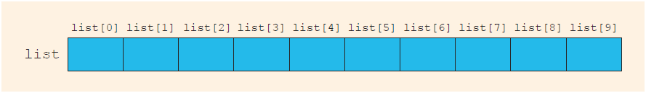
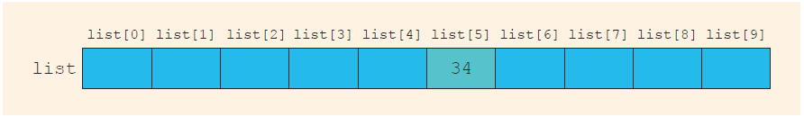
Accessing Array Components (2 of 3)
This statement declares an array of 10 components:
int list[10];
FIGURE 8-3 Array list
list[5] = 34;
stores 34 in list[5], the sixth component of the array list
FIGURE 8-4 Array list after execution of the statement list[5]= 34;

Slide 9
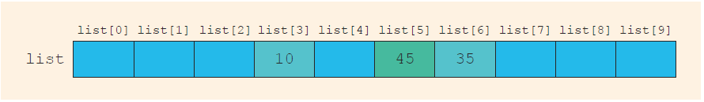
Accessing Array Components (3 of 3)
list[3] = 10;
list[6] = 35;
list[5] = list[3] + list[6];
FIGURE 8-5 Array list after execution of the statements list[3]= 10;, list[6]= 35;, and list[5] = list[3] + list[6];

Slide 10
Processing One-Dimensional Arrays (1 of 3)
Basic operations on a one-dimensional array include:
  Initializing
  Inputting data
  Outputting data stored in an array
  Finding the largest and/or smallest element
Each operation requires ability to step through elements of the array
  Easily accomplished using a loop

Slide 11
Processing One-Dimensional Arrays (2 of 3)
Given the declaration:
  int list[100]; //array of size 100
  int i;
Use a for loop to access array elements:
  for (i = 0; i < 100; i++) //Line 1
  cin >> list[i]; //Line 2

Slide 12
Processing One-Dimensional Arrays (3 of 3)
Refer to Example 8-3 in the text, which shows how loops are used to process arrays
  Initializing an array
  Reading data into an array
  Printing an array
  Finding the sum and average of an array
  Finding the largest element in an array

Slide 13
Array Index Out of Bounds
The index of an array is in bounds if the index is between 0 and
ARRAY_SIZE - 1
  Otherwise, the index is out of bounds
In C++, there is no guard against indices that are out of bounds
  This check is solely the programmer’s responsibility

Slide 14
Array Initialization During Declaration
Arrays can be initialized during declaration
  Values are placed between curly braces
Example 1
  double sales[5] = {12.25, 32.50, 16.90, 23, 45.68}
Example 2: the array size is determined by the number of initial values in the braces if the array is declared without size specified
  double sales[] = {12.25, 32.50, 16.90, 23, 45.68}

Slide 15
Partial Initialization of Arrays During Declaration
The statement:
  int list[10] = {0};
  Declares an array of 10 components and initializes all of them to zero
The statement (an example of partial initialization of an array during declaration):
  int list[10] = {8, 5, 12};
  Declares an array of 10 components and initializes list[0] to 8, list[1] to 5, list[2] to 12
  All other components are initialized to 0

Slide 16
Some Restrictions on Array Processing
Aggregate operation: any operation that manipulates the entire array as a single unit
  Not allowed on arrays in C++
Example
int myList[5] = {0, 4, 8, 12, 16}; //Line 1
int yourList[5]; //Line 2
yourList = myList; //illegal
Solution
for (int index = 0; index < 5; index++)
yourList[index] = myList[index];

Slide 17
Arrays as Parameters to Functions
Arrays are passed by reference only
Do not use symbol & when declaring an array as a formal parameter
The size of the array is usually omitted in the array parameter
  If provided, it is ignored by the compiler
The following example illustrates a function header, which includes an array parameter and a parameter specifying the number of elements in the array:
  void initialize(int list[], int listSize)

Slide 18
Constant Arrays as Formal Parameters
Can prevent a function from changing the actual parameter when passed by reference
  Use const in the declaration of the formal parameter
Example
  void example(int x[], const int y[], int sizeX, int sizeY)

Slide 19
Base Address of an Array and Array in Computer Memory
The base address of an array is the address (memory location) of the first array component
  If list is a one-dimensional array, its base address is the address of list[0]
When an array is passed as a parameter, the base address of the actual array is passed to the formal parameter

Slide 20
Functions Cannot Return a Value of the Type Array
C++ does not allow functions to return a value of type array
Refer to Example 8-6 in the text
  Functions sumArray and indexLargestElement

Slide 21
Integral Data Type and Array Indices
C++ allows any integral type to be used as an array index
  Improves code readability
The following code illustrates improved readability:
enum paintType {GREEN, RED, BLUE, BROWN, WHITE, ORANGE,
YELLOW};
double paintSale[7];
paintType paint;
for (paint = GREEN; paint <= YELLOW;
paint = static_cast<paintType>(paint + 1))
paintSale[paint] = 0.0;
paintSale[RED] = paintSale[RED] + 75.69;

Slide 22
Other Ways to Declare Arrays
Example 1
  const int NO_OF_STUDENTS = 20;
  int testScores[NO_OF_STUDENTS];
Example 2
  const int SIZE = 50; //Line 1
  typedef double list[SIZE]; //Line 2
  list yourList; //Line 3
  list myList; //Line 4

Slide 23
Searching an Array for a Specific Item
Sequential search (or linear search)
  Searching a list for a given item, starting from the first array element
  Compare each element in the array with value that is being searched
  Continue the search until item is found or no more data is left in the list

Slide 24
Sorting
Selection sort: rearrange the list by selecting an element and moving it to its proper position
Steps for a selection sort:
  Find the smallest element in the unsorted portion of the list
  Move it to the top of the unsorted portion by swapping with the element currently there
  Start again with the rest of the list

Slide 25
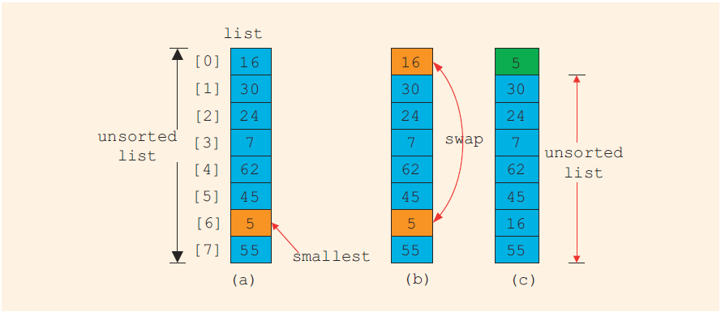
Selection Sort
FIGURE 8-10 Elements of list during the first iteration

Slide 26
Auto Declaration and Range-Based for Loops
C++11 allows auto declaration of variables
  Data type does not need to be specified
  auto num = 15;
  The type of num will be int
Range-based for loop
double list[25];
double sum;
sum = 0;
for (double num : list) // read as “for each num in list”
sum = sum + num;

Slide 27
C-Strings (Character Arrays) (1 of 3)
A character array is an array whose components are of type char
C-strings are null-terminated ('\0') character arrays
Examples
  'A' is the character A
  "A" is the C-string A
  Note: "A" represents two characters, 'A' and '\0'

Slide 28
C-Strings (Character Arrays) (2 of 3)
This is an example of a C-string declaration:
  char name[16];
Since C-strings are null terminated and name has 16 components, the largest string it can store has 15 characters
If you store a string whose length is less than the array size, the last components are unused

Slide 29
C-Strings (Character Arrays) (3 of 3)
The size of an array can be omitted if the array is initialized during declaration
  char name[] = "John";
  Declares an array of length 5 and stores the C-string "John" in the array
Useful string manipulation functions include:
  strcpy
  strncpy
  strcmp
  strlen

Slide 30
String Comparison
C-strings are compared character by character using the collating sequence of the system
  Use the function strcmp
If using the ASCII character set:
  "Air" < "Boat"
  "Air" < "An"
  "Bill" < "Billy"
  "Hello" < "hello"

Slide 31
Reading and Writing Strings
Most rules for arrays also apply to C-strings (which are character arrays)
Aggregate operations, such as assignment and comparison, are not allowed on arrays
C++ does allow aggregate operations for the input and output of C-strings

Slide 32
String Input
This is an example of string input:
cin >> name;
  Stores the next input C-string into name
To read strings with blanks, use the function get:
cin.get(str, m+1);
  When executed , the statement stores the next m characters into str, but the newline character is not stored in str
  If input string has fewer than m characters, reading stops at the newline character

Slide 33
String Output
Example
  cout << name;
  Outputs the content of name on the screen
  << continues to write the contents of name until it finds the null character
  If name does not contain the null character, then strange output may occur since << continues to output data from memory adjacent to name until a '\0' is found

Slide 34
Specifying Input/Output Files at Execution Time
User can specify the name of an input and/or output file at execution time
cout << "Enter the input file name: ";
cin >> fileName;
infile.open(fileName); //open the input file
.
.
.
cout << "Enter the output file name: ";
cin >> fileName;
outfile.open(fileName); //open the output file

Slide 35
string Type and Input/Output Files
Argument to the open function must be a null-terminated string (a C-string)
  If using a string variable for the name of an I/O file, the value must first be converted to a C-string before calling open
    Use the c_str function to convert
The syntax to use the function c_str is:
  strVar.c_str()
  Where strVar is a variable of type string

Slide 36
Parallel Arrays
Two (or more) arrays are called parallel if their corresponding components hold related information
The following example illustrates two parallel arrays:
  int studentId[50];
  char courseGrade[50];
  With the following sample data to enter into the arrays:
  studentId courseGrade
  23456 A
  86723 B
  22356 C
  92733 B
  11892 D
  .
  .
  .

Slide 37
Two- and Multidimensional Arrays
Two-dimensional array: a collection of a fixed number of components (of the same type) arranged in two dimensions
  Sometimes called matrices or tables
Declaration syntax
  intExp1 and intExp2 are expressions with positive integer values specifying the number of rows and columns in the array

Slide 38

Accessing Array Components (1 of 2)
Syntax to access a component in a two-dimensional array
  Where indexExp1 and indexExp2 are expressions with positive integer values, and specify the row and column position
  Example: sales[5][3] = 25.75;

Slide 39
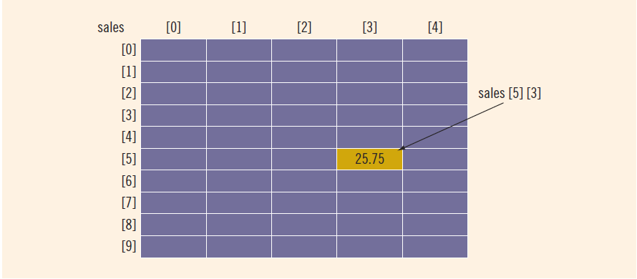
Accessing Array Components (2 of 2)
FIGURE 8-14 sales[5][3]

Slide 40
Two-Dimensional Array Initialization During Declaration
Two-dimensional arrays can be initialized when they are declared
  Elements of each row are enclosed within braces and separated by commas
  All rows are enclosed within braces
  For number arrays, unspecified elements are set to 0
An example of two-dimensional array initialization is shown below:
  int board[4][3] = {{2, 3, 1},
  {15, 25, 13},
  {20, 4, 7},
  {11, 18, 14}};

Slide 41
Two-Dimensional Arrays and Enumeration Types
Enumeration types can be used for array indices
  const int NUMBER_OF_ROWS = 6;
  const int NUMBER_OF_COLUMNS = 5;
  enum carType {GM, FORD, TOYOTA, BMW, NISSAN, VOLVO};
  enum colorType {RED, BROWN, BLACK, WHITE, GRAY};
  int inStock[NUMBER_OF_ROWS][NUMBER_OF_COLUMNS];

Slide 42
Processing Two-Dimensional Arrays
Ways to process a two-dimensional array:
  Process a single element
  Process the entire array
  Process a single row at a time, called row processing
  Process a single column at a time, called column processing
Each row and each column of a two-dimensional array is a one-dimensional array
  To process, use algorithms similar to processing one-dimensional arrays

Slide 43
Initialization
An example initializing row number 4 (fifth row) to 0:
  row = 4;
  for (col = 0; col < NUMBER_OF_COLUMNS; col++)
  matrix[row][col] = 0;
An example initializing the entire matrix to 0
  for (row = 0; row < NUMBER_OF_ROWS; row++)
  for (col = 0; col < NUMBER_OF_COLUMNS; col++)
  matrix[row][col] = 0;

Slide 44
Print
Use a nested loop to output the components of a two dimensional array
  for (row = 0; row < NUMBER_OF_ROWS; row++)
  for (col = 0; col < NUMBER_OF_COLUMNS; col++)
  cout << setw(5) << matrix[row][col] << " ";
  cout << endl;

Slide 45
Input
An example of adding input to row number 4 (fifth row):
  row = 4;
  for (col = 0; col < NUMBER_OF_COLUMNS; col++)
  cin >> matrix[row][col];
An example of adding input to each component of matrix:
  for (row = 0; row < NUMBER_OF_ROWS; row++)
  for (col = 0; col < NUMBER_OF_COLUMNS; col++)
  cin >> matrix[row][col];

Slide 46
Sum by Row
The following example shows how to find the sum of row number 4:
  sum = 0;
  row = 4;
  for (col = 0; col < NUMBER_OF_COLUMNS; col++)
  sum = sum + matrix[row][col];

Slide 47
Sum by Column
The following example illustrates finding the sum of each individual column:
  //Sum of each individual row
  for (row = 0; row < NUMBER_OF_ROWS; row++)
  {
  sum = 0;
  for (col = 0; col < NUMBER_OF_COLUMNS; col++)
  sum = sum + matrix[row][col];
  cout << "Sum of row " << row + 1 << " = " << sum << endl;
  }

Slide 48
Largest Element in Each Row and Each Column
The following example finds the largest element in each row:
  //Largest element in each row
  for (row = 0; row < NUMBER_OF_ROWS; row++)
  {
  largest = matrix[row][0]; //Assume the first element
  //of the row is the largest.
  for (col = 1; col < NUMBER_OF_COLUMNS; col++)
  if (matrix[row][col] > largest)
  largest = matrix[row][col];
  cout << "The largest element in row " << row + 1
  << " = " << largest << endl;
  }

Slide 49
Passing Two-Dimensional Arrays as Parameters to Functions
Two-dimensional arrays are passed by reference as parameters to a function
  The base address is passed to the formal parameter
Two-dimensional arrays are stored in row order form
When declaring a two-dimensional array as a formal parameter, you can omit the size of the first dimension, but not the second

Slide 50
Arrays of Strings
Strings in C++ can be manipulated using either the data type string or character arrays (C-strings)

Slide 51
Arrays of Strings and the string Type
The example below declares an array of 100 components of type string:
  string list[100];
Basic operations, such as assignment, comparison, and input/output, can be performed on values of the string type
The data in list can be processed just like any one-dimensional array

Slide 52
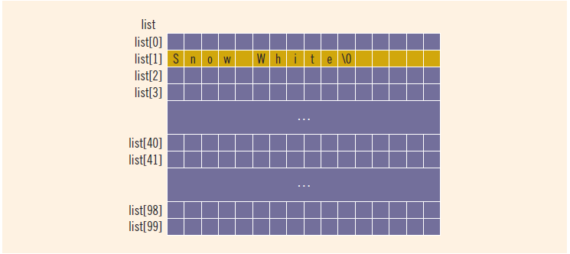
Arrays of Strings and C-Strings (Character Arrays)
strcpy(list[1], "Snow White");
FIGURE 8-20 Array list, showing list[1]

Slide 53
Another Way to Declare a Two-Dimensional Array
Can use typedef to define a two-dimensional array data type:
  const int NUMBER_OF_ROWS = 20;
  const int NUMBER_OF_COLUMNS = 10;
  typedef int tableType[NUMBER_OF_ROWS][NUMBER_OF_COLUMNS];
This statement declares an array of 20 rows and 10 columns:
  tableType matrix;

Slide 54
Multidimensional Arrays
n-dimensional array: a collection of a fixed number of elements arranged in n dimensions (n >= 1)
Declaration syntax
Code to access a component

Slide 55
Quick Review (1 of 4)
An array is a structured data type with a fixed number of components of the same type
  Components are accessed using their relative positions in the array
Elements of a one-dimensional array are arranged in the form of a list
An array index can be any expression that evaluates to a nonnegative integer
  Must always be less than the size of the array

Slide 56
Quick Review (2 of 4)
The base address of an array is the address of the first array component
When passing an array as an actual parameter, use only its name
  Passed by reference only
A function cannot return an array type value
Individual array components can be passed as parameters to functions

Slide 57
Quick Review (3 of 4)
In C++, C-strings are null terminated and are stored in character arrays
Commonly used C-string manipulation functions include: strcpy, strncpy, strcmp, strncmp, and strlen
Parallel arrays hold related information
In a two-dimensional array, the elements are arranged in a table form

Slide 58
Quick Review (4 of 4)
To access an element of a two-dimensional array, you need a pair of indices: one for row position, one for column position
In row processing, a two-dimensional array is processed one row at a time
In column processing, a two-dimensional array is processed one column at a time

